Slide 1
超越学科界限的认知基础 Transdisciplinary Cognitive Foundation Review the Basics Week 13
Ben Koo
December 7, 2020

Slide 2
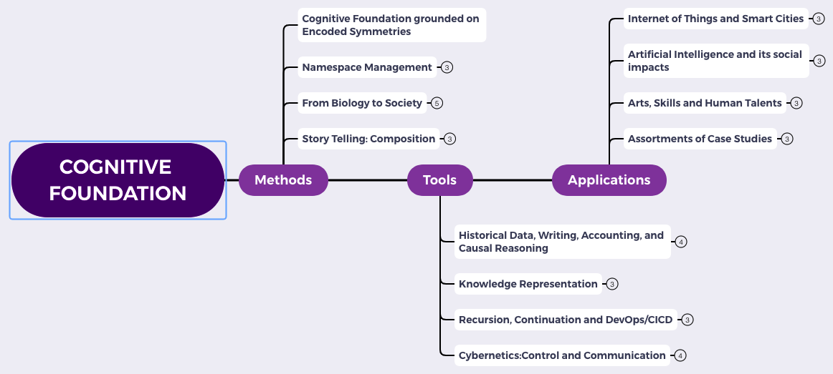
Content Themes for the semester
Overview
Namespace Management
Biology, Physics, Math, Code is Law, and Society
Story Telling, Functions/Metaphors/Analogies
Writing, Accounting, Historical Data and Temporal Reasoning
Knowledge Representation in Wiki and Files
Recursion and Continuation (DevOps/CICD)
Midterm Reports by Students
Cybernetics (Control and Communication)
Smart City and Internet of Things
Artificial Intelligence and its Social Impacts
Arts/Skills/Human Talents in the Digital Era
Student proposed Application Topics
Rehearsal
Final Reports and Celebration

Slide 3

Logic Model
Logic Model
Output: Some written strategy, in Logic Model format, for your final paper
Process: Construct an outline of your paper, that touches on Soundness and Completeness.
Input:
Present a theory that is “sound”.
Present a meaningful case study, that fits your theory
Showing that it is Sound and Complete
Context: We are at the last stretch of the semester. Students have to show whether they digested the materials presented so far.
Goal: Become aware of a System of Transdisciplinary Performance Metric.
Criteria:
Soundness: Once proved by your theory, it is valid.
Completeness: Once known valid, it can be proved.
A well-defined set of Actions and iterative Branching Strategies
A Roadmap of composable activities
Sequencing and timing conditions
Explicitly state dependencies and resource requirements
Boundary Conditions: audience must have sufficient experience in Logic Model.

Slide 4

What if a Unifying Foundation doesn’t exist?
What if there are many Cognitive Foundations?
We might assume that humans and aliens have significantly different cognitive frameworks.
But, are the fundamentally different?
Can there be any “connections”?
It is like admitting there exists some completely exotic species…

Slide 5
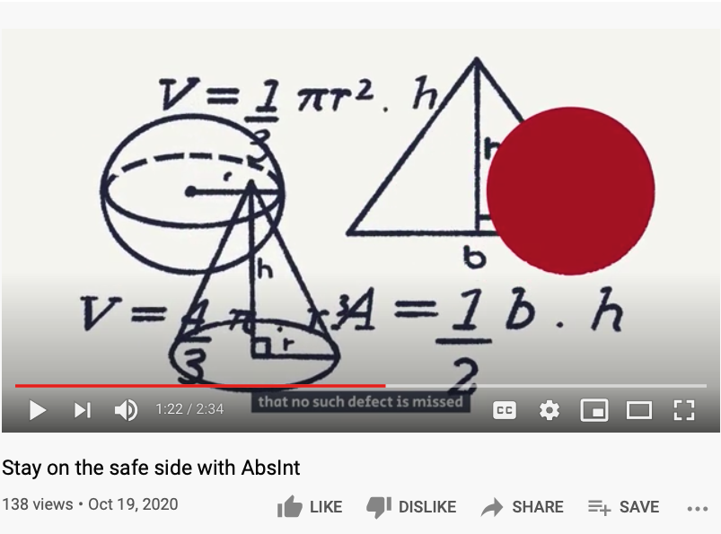
A Sound Foundation for Computational Tools?
A commercial by a German company
The website of absint.com stated: “Safety standards like ISO 26262, DO-178B, DO-178C, IEC-61508, and EN-50128 require identifying functional and non-functional hazards and demonstrating that the soft­ware does not violate the rele­vant safety goals.”

Slide 6
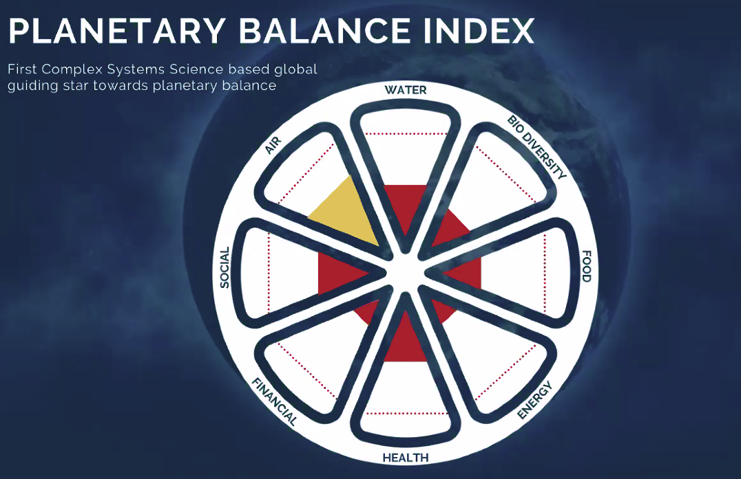
What I learned this weekend?
A possible candidate for “Enlightened” metrics

Slide 7
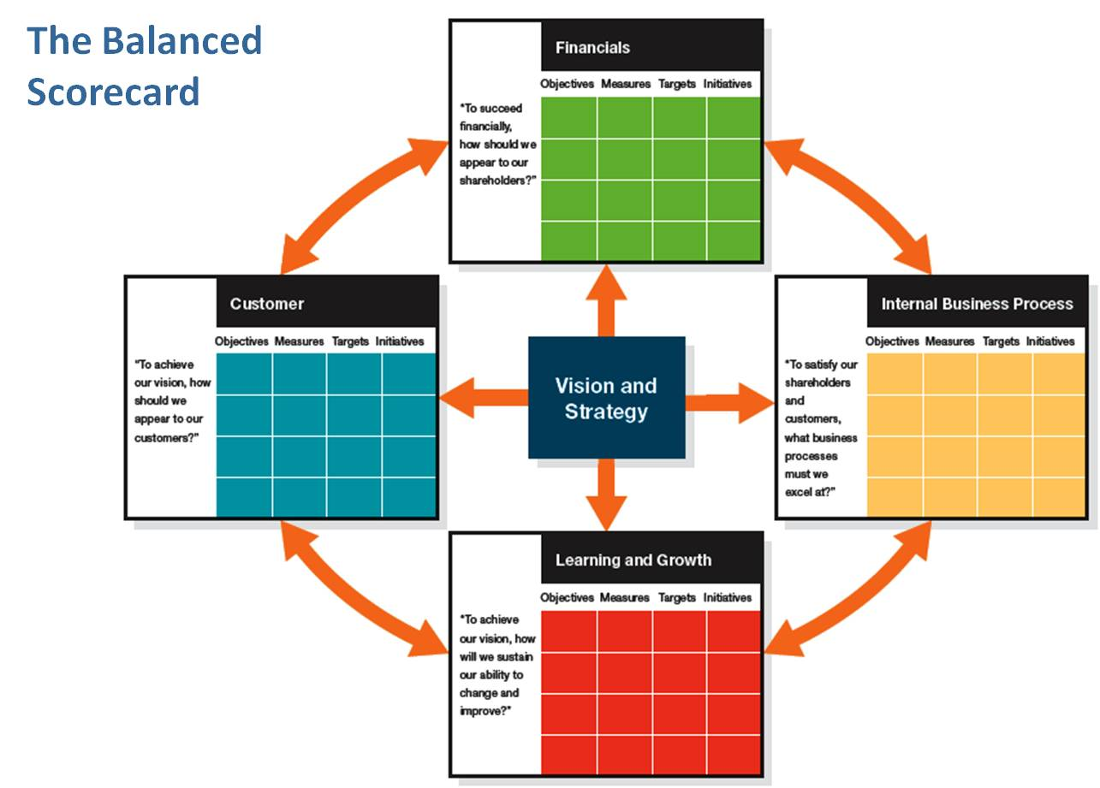
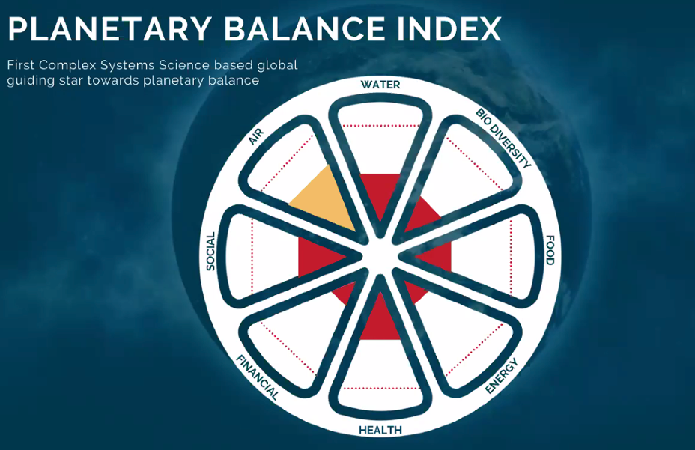
What makes a metric system “sound and complete”?
The BSC pioneered by
Robert Kaplan and David Norton
How to know whether this metric system
Is or Isn’t Sound and Complete?
Image source: by Suleiman Shehu

Slide 8
Mapping from 8 to 4 measurement components
How to know whether this metric system
Is or Isn’t Sound and Complete?
Image source: by Suleiman Shehu

Slide 9

Color code and rearrange the “Balanced Index”
Energy
(Initial Object)
Financial
Food
Air
Health
Water
Internal Social
External Social
Bio Diversity
(Terminal Object)
Learning and Growth

Slide 10
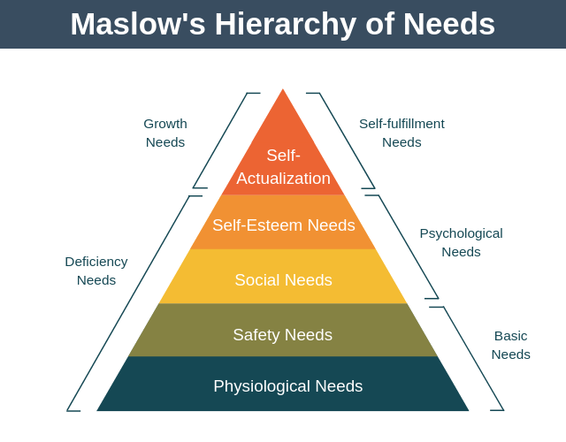
What kind of Data Structures fit these patterns?
Bio Diversity
(Terminal Object)
Terminal Object
Internal Social
External Social
Air
Health
Water
Food
Financial
Energy
(Initial Object)
Initial Object

Slide 11
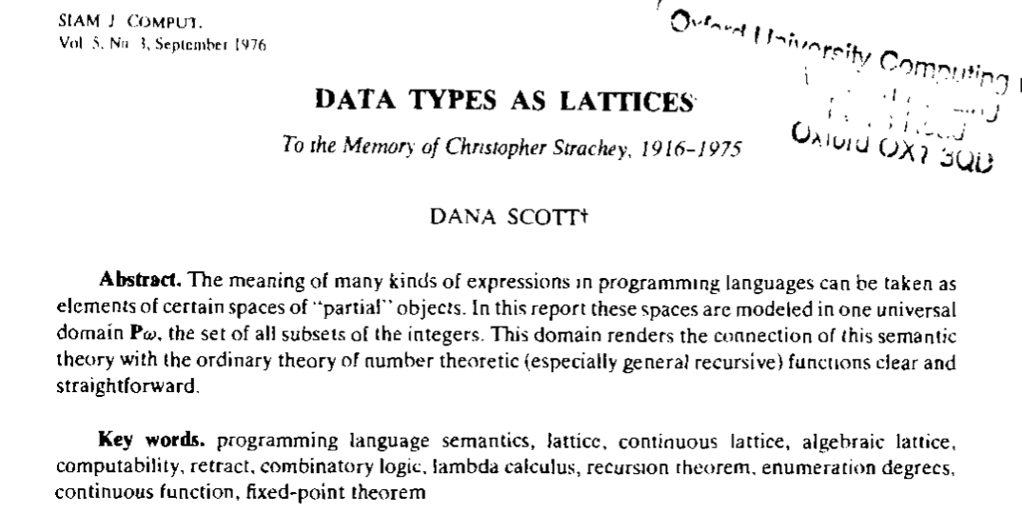
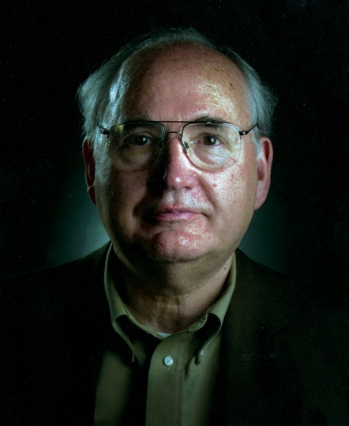
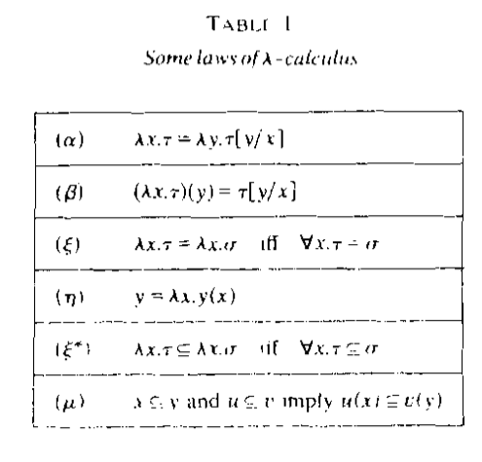
All meaningful expressions can be modeled as $𝒫ω$
Prof. Dana Stewart Scott
Image Source: Britannica

Slide 12
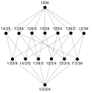
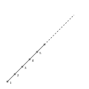
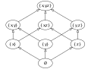
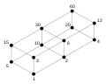
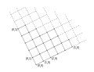
What is a Lattice?
Pic. 1: Subsets of {x, y, z}, under set inclusion. The name "lattice" is suggested by the form of the Hasse diagram depicting it.
Pic. 2: Lattice of integer divisors of 60, ordered by "divides".
Pic. 3: Lattice of partitions of {1, 2, 3, 4}, ordered by "refines".
Pic. 4: Lattice of positive integers, ordered by ≤.
Pic. 5: Lattice of nonnegative integer pairs, ordered component wise.
Source of Images and Text : https://en.wikipedia.org/wiki/Lattice_(order)

Slide 13
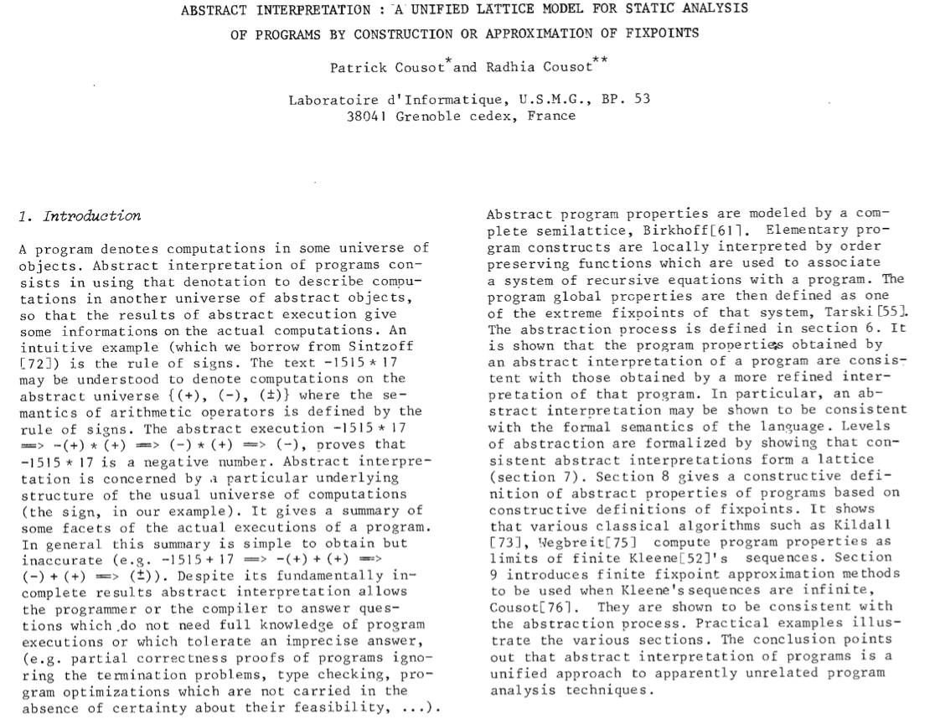
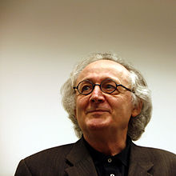
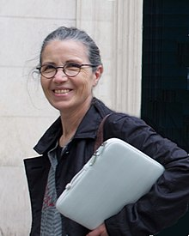
Lattice represents a Universal Data Type
Patrick Cousot
Radhia Cousot
Source of Text : https://www.di.ens.fr/~cousot/publications.www/CousotCousot-POPL-77-ACM-p238--252-1977.pdf

Slide 14
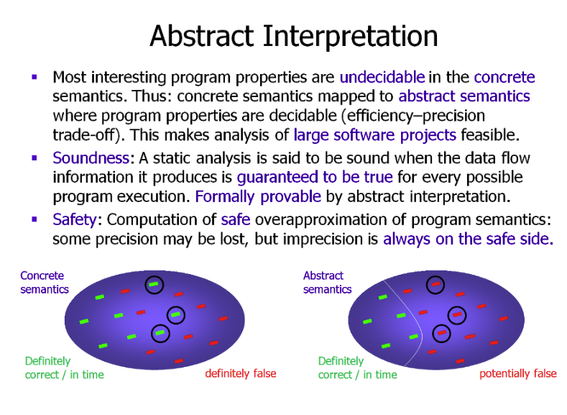
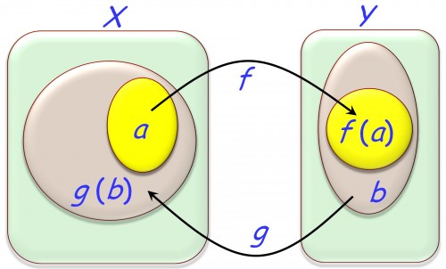
The Abstract and Concrete Domains
You may think of different colors represent different “intervals”. Where intervals are representable as bounded regions mathematically modeled as Lattices or Posets..

Slide 15
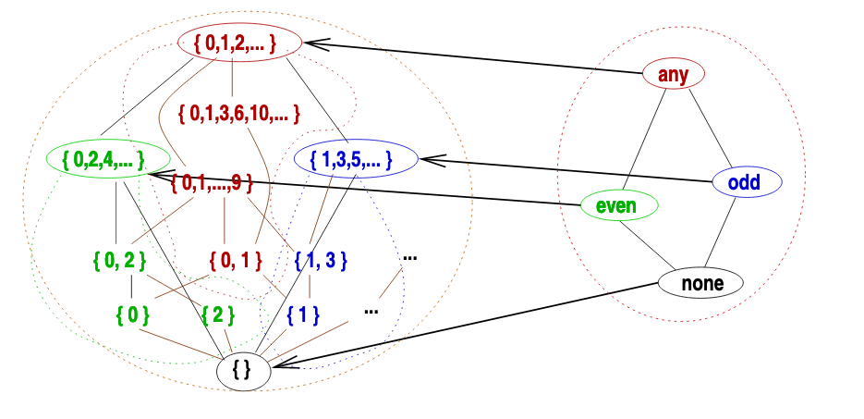
All Computation (decisions) are approximations
A lattice (L, ⊑, ⊥, ⊔, ⊤, ⊓) is a partially ordered set (L, ⊑) with:
Least upper bounds (⊔) and greatest lower bounds (⊔) operators
A least element “bottom”: ⊥
A greatest element “top”: ⊤
L is complete if all least upper bounds exist
A fixpoint X of F: L → L satisfies F(X) = X
We denote by lfp F the least fixpoint if it exists

Slide 16

Fixpoint Theorems/Mathematical Ouroboros
Knaster-Tarski theorem: If F: L → L is monotone and L is a complete lattice, the set of fixpoints of F is also a complete lattice.
Kleene theorem: If F: L → L is monotone, L is a complete lattice and F preserves all least upper bounds then lfp F is the limit of the sequence:
F₀ = ⊥
F_{n+1} = F (F_{n})

Slide 17
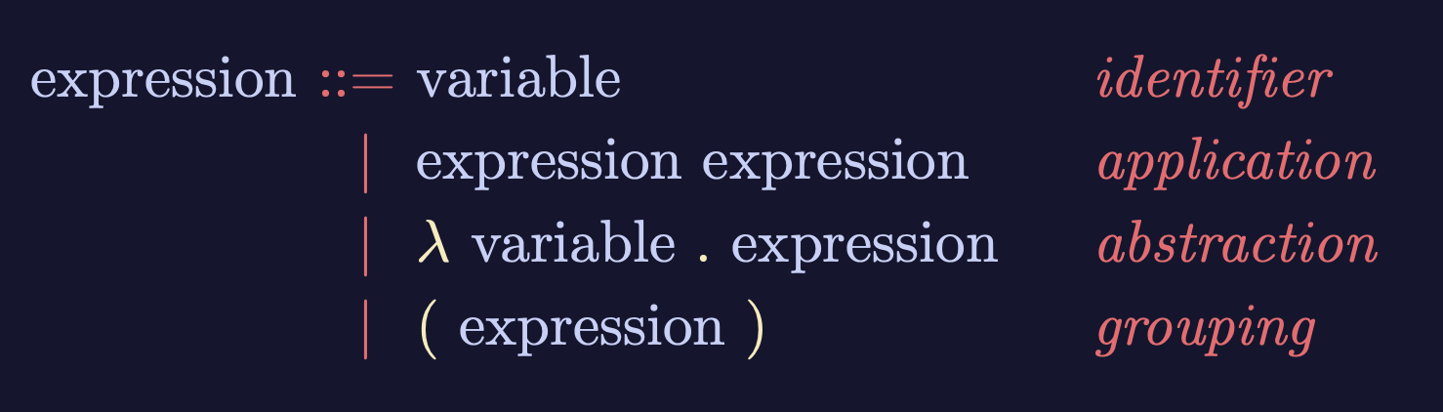
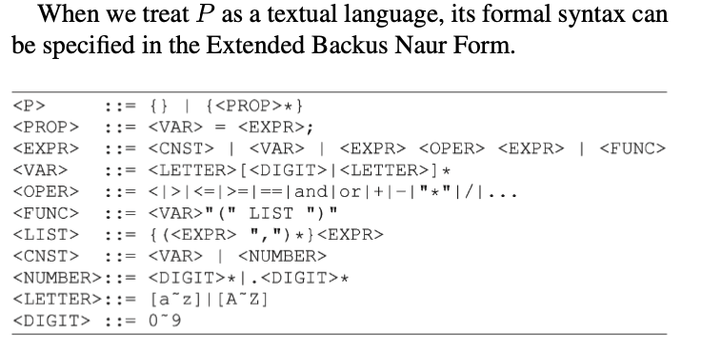
Lambda-Calculus is an Ouroboros
Variable
Expression1
Expression2
𝜆
Variable
Expression
( )
Expression
Lambda calculus as an executable rewrite process is a Lattice/Poset.
Paradigm shifting concepts
and
incommensurable terms
Normal Science
Model
Drift
Model Crisis
Model Revolution
Paradigm
Change
Learning as a vocabulary acquisition process!
Backus-Naur Form provides a way to customize the “concrete syntax” of formal languages.

Slide 18

Ouroboros connects the beginning with the end
Lambda Calculus are composed of Expressions,
and
Expressions are composed of other expressions…
Variable
Expression1
Expression2
𝜆
Variable
Expression
( )
Expression
Lambda calculus as an executable rewrite process is a Lattice/Poset.
Early alchemical ouroboros illustration with the words ἓν τὸ πᾶν ("The All is One") from the work of Cleopatra the Alchemist in MS Marciana gr. Z. 299. (10th Century)
Image and Text: Wikipedia

Slide 19
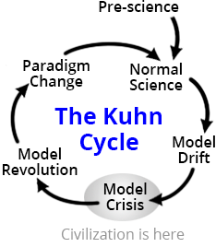
Recursion/Iteration:
connects the beginning with the end
Lambda Calculus are composed of Expressions,
and
Expressions are composed of other expressions…
Variable
Expression1
Expression2
𝜆
Variable
Expression
( )
Expression
Lambda calculus as an executable rewrite process is a Lattice/Poset.

Slide 20
Recursion/Iteration:
connects the beginning with the end
Every KIND of Lambda Expression is a Type,
and
a small number of Types can be Computationally Complete…
a
Variable
b
Expression1
Expression2
c
𝜆
Variable
Expression
( )
d
Expression
e (empty type)

Slide 21
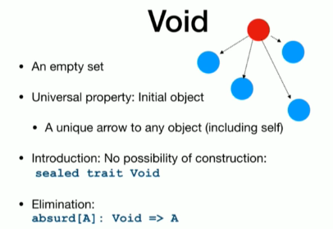
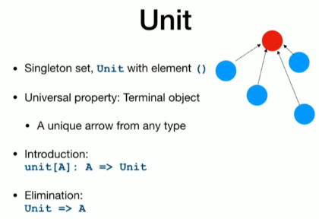
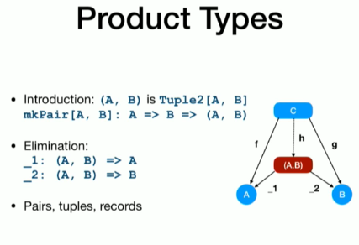
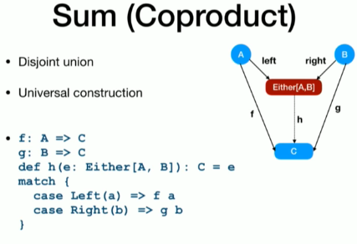
A few screen shot for basic data types?
Variable
Expression1
Expression2
𝜆
Variable
Expression
( )
Expression

Slide 22


Types in Name Space Management
Every KIND of Lambda Expression is a Type,
and
a small number of Types can be Computationally Complete…
a
Variable
b
Expression1
Expression2
c
𝜆
Variable
Expression
( )
d
Expression
e (empty type)

Slide 23
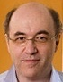
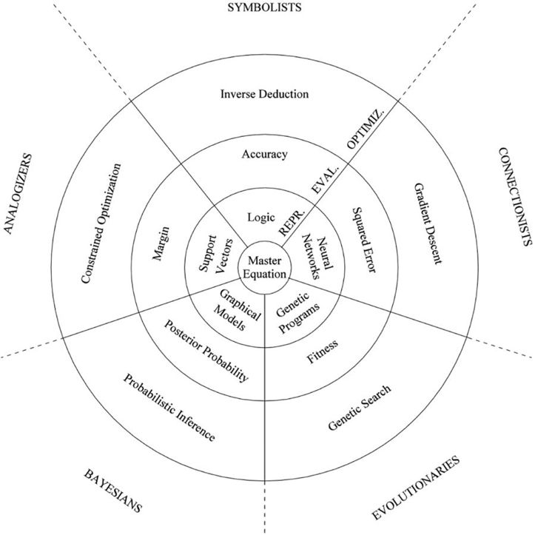



The Allegory of the Master Algorithm
（寓言）
The Allegory of a Smart City made of 3 concentric circles and occupied by 5 tribes:
Circles:
Optimization (Search)
Evaluation (Assessment and Rewrite)
Representation (NsM)
Practical Concerns:
Optimization (Search)
Scalability
Evaluation (Assessment and Rewrite)
Correctness
Representation (NsM)
Sound/Complete
Master
Equation
Chinese Translation
Image Source: P. 240 of The Master Algorithm
23

Slide 24

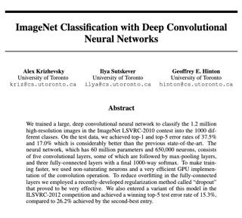
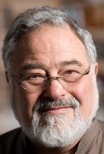
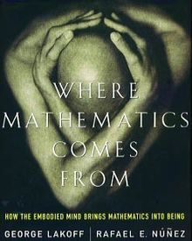


The Leaders of the Five Tribes
Image Source: P. 240 of The Master Algorithm
24

Slide 25

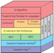


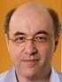








An integrated (ethical) architecture
to implement the Master Algorithm
Software
Hardware
Scientific “Evolution”
Neutral Network
Symbolic Logic
Causal Probability
Conceptual Analogies
T. Kuhn
Content
IoT and Quantum Computing
TPU
GPU
CPU
Big Data
Computed Data
Artificial Data
Resource
Standard
J. Hinton
Distributed
Centralized
General Protocol
S. Wolfram
J. Pearl
Governance Strategies
Collective learning systems
Data Assets, Structures
Extreme Learning Process
G. Lakoff
Computing Architectures, Instrumentation
Encoding strategy, Ontology, Epistemology

Slide 26
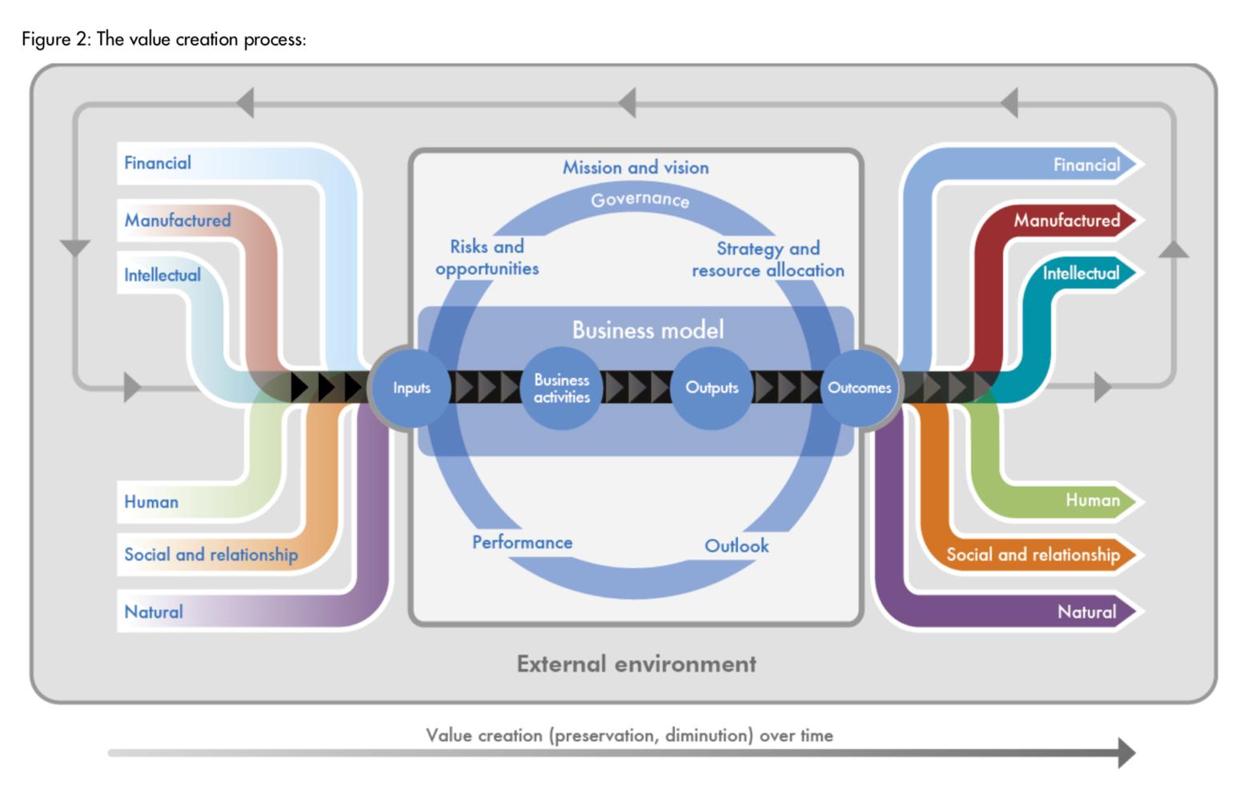

Accountants’ Ouroboros
The International
Integrated Reporting
Framework
Dec. 2013
Notes:
“historian James Aho linked double-entry bookkeeping to the ancient art of rhetoric,”
Excerpt From: Jane Gleeson-White. “Double Entry.” Apple Books.

Slide 27
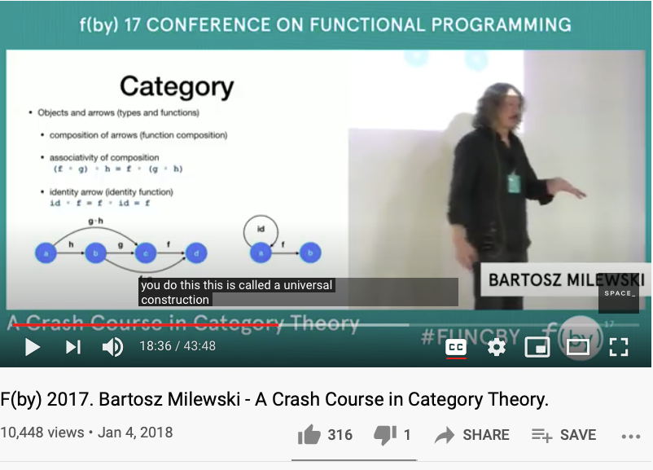
A Quick Review of Universal Objects in Category Theory
https://youtu.be/iJ7V1KXJpsE?t=1116

Slide 28

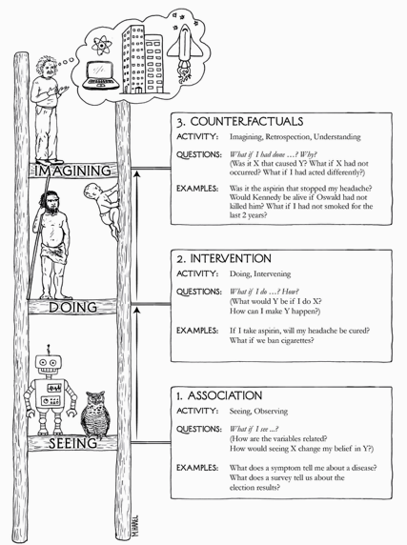
The Three Stages of the Cognitive Ladder
Why/Counterfactuals
Learning comes from What if assumptions…
How/Intervention
perform action under “Free” will
What/Association
the common observables

Slide 29
How big is the size of What If possibilities?
How/Intervention (a methodical way to intervene complexity)
Most of the operational what-if possibility spaces are rather small, so that people can deal with them with their “natural” talents…
Big Data (Software Industry) and AI brings complexity to an operational level, small code changes could result in major consequences in software controlled systems, which is almost everything we deal with on daily basis …
How to keep Abstraction separated from Concretization?
The Cognitive Discipline wrapped around in: Namespace Management (NsM).
What if complexity becomes overwhelming? Recursively apply NsM!

Slide 30
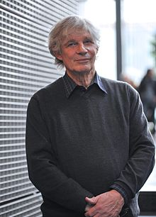
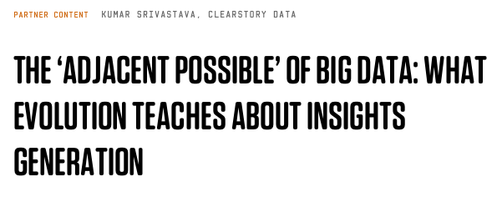
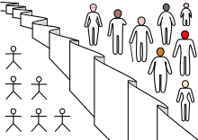
What foundation is universally trust-worthy?
What/Association (a unitary foundation)
Is there a generic data type/algebraic structure that is applicable to all?
Poset/Lattice/Monad (the foundational abstract data type) has concrete specification, and can be stored, and manipulated using scalable computing devices …
The ”Associations” in Partially Ordered Set: Adjacent Possibilities (Stuart Kauffman)
Wikipedia: Veil of Ignorance

Slide 31
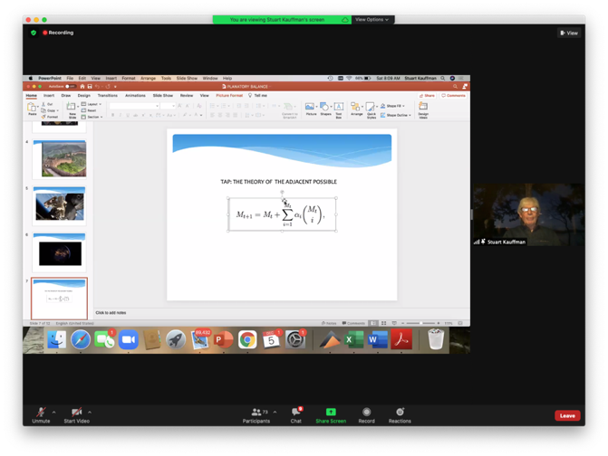



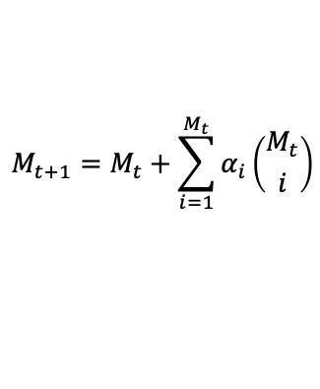
A Unifying Formula by Stuart Kauffman
The Theory of the Adjacent Possible
$$M_{t+1}=M_{t}+\sum_{i=1}^{M_{t}}{α_{i}\left({M_{t} \atop i}\right)}$$
Complexity Coherence Conference 2020
Stuartt Kauffman is an American medical doctor, theoretical biologist, and complex systemsresearcher who studies the origin of life on Earth. - wikipedia

Slide 32
What is the idea of Nature?
The Chinese phrase for Nature is: 自然！
Huawei VP Mr. Yang Shaoqing
The notion of “self” is related to the notion of
Identity morphism in Category Theory
Where the highest order of morphisms is called:
Natural Transformation

Slide 33
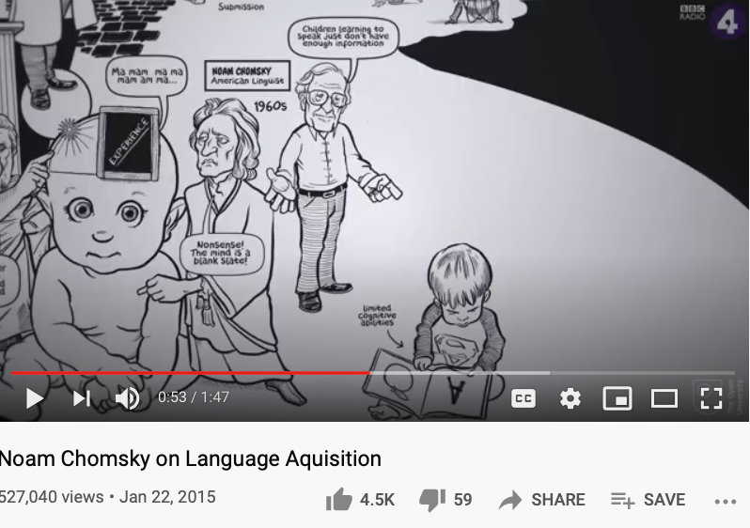
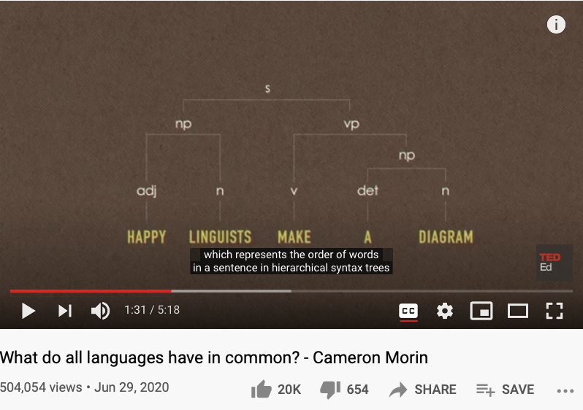
What is a “Self” ?
Is there a finite set of actions to verify the existence of self?
Is there a “universal grammar” that is applicable to all?
https://www.openculture.com/2019/02/a-brief-animated-introduction-to-noam-chomskys-linguistic-theory-narrated-by-the-x-files-gillian-anderson.html

Slide 34
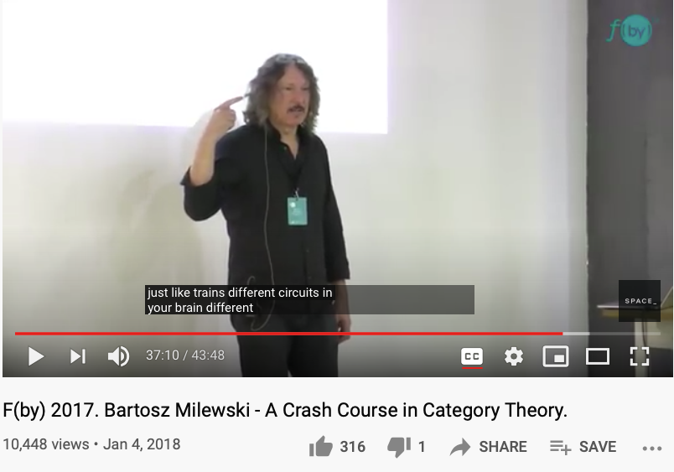
What if a there is a secrete way to attain cognitive Universality?
It is like admitting there exists some completely exotic species…

Slide 35
Why Category Theory for Cognitive Foundation?
It is the smallest yet universal representation of concepts, so that it will fit into operational contexts when needed…

Slide 36
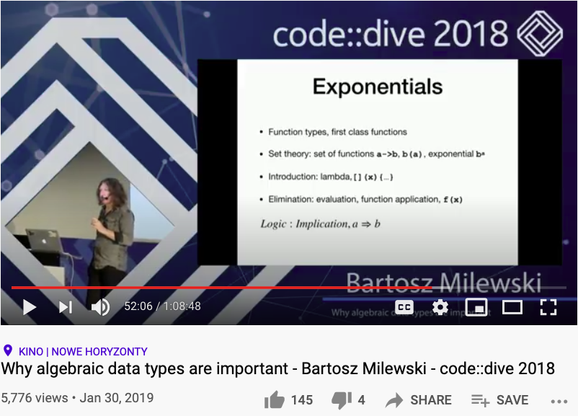
The Cognitive Connections: Linking Lambda abstraction with Arithmetic
Huawei VP Mr. Yang Shaoqing
https://youtu.be/LkqTLJK2API?t=3126

Slide 37
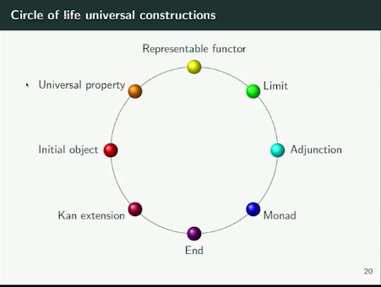
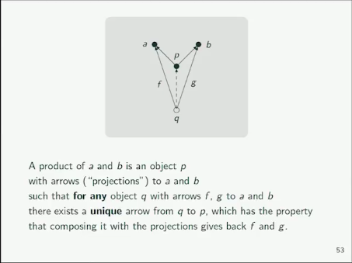
When explaining the idea of Universal Properties …
We have explained certain aspects of all other properties in the ring.
Huawei VP Mr. Yang Shaoqing

Slide 38
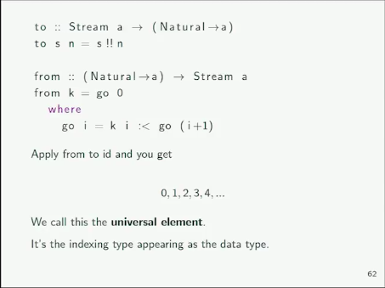
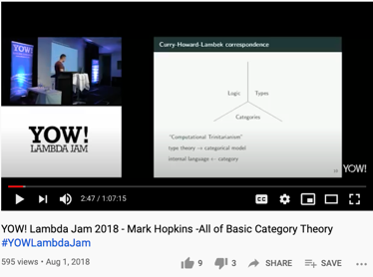
Stream as a Data Type is called the Universal Element
Huawei VP Mr. Yang Shaoqing
https://youtu.be/9u1q3lH7VbE?t=1205（explaination starts at 20:05）

Slide 39
We live in a Smart World,
Driven by Physically Meaningful Data
Image credits: http://verses.io

Slide 40

Operationalizing the Cybernetics
How to deploy a Kubernetes Cluster from Scratch (Youtube Link)

Slide 41
What, How and Why of “operationalization”
What/Association the common observables
How/Intervention perform action under “Free” will
Why/Counterfactuals the revealing “truth” or “surprises” related to relevant spacetime contexts
When all the data are driven by one consistent (foundational) framework
A new kind (previously incommensurable) model of belief system will emerge

Slide 42


Kuhn Cycle: the evolution of a Namespace
Normal Science
Model
Drift
Model Crisis
Model Revolution
Paradigm
Change
Emerging cases or
systematic attacks
Product Development Process
in five stages
Commit
Build
Test
Stage
Deploy
Unknown/incompatible names introduces crisis. (incommensurability).

Slide 43







A Multi-Scale Collective Cognitive Processes
(students/teachers)
(Smart) Social Contract Execution
Traders
Miners
Coders
(Consumers/Distributors)
Three Asynchronous
Clocks in their respective
Communities
Version Upgrade
Production Code
Function Requests
Customer Crisis
Feature Revolution
Emerging cases or
systematic attacks
(Artists/Creative Projects)
(Administrators/Witnesses)
Perform Checking
receive confirmation
commit transaction
(Content Producers/Product Designers)
(Accountants/Lawyers)

Slide 44
Accountants’ Value Proposition
The International
Integrated Reporting
Framework
Dec. 2013
Notes:
“historian James Aho linked double-entry bookkeeping to the ancient art of rhetoric,”
Excerpt From: Jane Gleeson-White. “Double Entry.” Apple Books.

Slide 45




Holacracy: a mechanism for Communication and Control
Variable
Expression1
Expression2
𝜆
Variable
Expression
( )
Expression
Holacracy applied Recursively
Image Source: Holacracy: The New Management System for a Rapidly Changing World

Slide 46

Some idea of Implementation?
Huawei VP Mr. Yang Shaoqing
Jonas Freeman,
Organizer of the 2020 Complexity Coherence Conference

Slide 47


Some idea of Implementation?
Any system of governance must deal with two complementary criteria: Soundness and Completeness
Huawei VP Mr. Yang Shaoqing
Foundation of Global Governance on p.445:
Accountability
Transparency
Consultation
The rule of law
Wikipedia: Amartya Kumar Sen
Arthur Dahl is one of the Speaker the 2020 Complexity Coherence Conference

Slide 48



The arrow diagram in Cyberspace
市场
Far
Space
Near
架构
执法
Before Time After
常态
Image Source: page 123 of Code V2 by L. Lessig
Notes:
我们这一套体系最基础的模型就是基于芝加哥学派所划出的产业发展四力模型而出的。

Slide 49

The version that includes modern cybernetic tools
Far
Space
near
before Time after

Slide 50

All events are Emerging Events
Normal Operations
Drifting Norms
Operational Crisis
User Revolution
Version Upgrade
Emerging cases or
systematic attacks
Self-Actualization
Esteem
Love and Belonging
Safety and Security
Physiological needs
Maslow’s Hierarchy of Needs

Slide 51

DevOps Goals for Governance
Notes:
1. 對稱性是底層的不變性
2. 在Cyberspace上，數據、操作數據的方式、操作數據的基礎架構，是資產的根本
3. 邏輯模型是凝聚群體意識的有效框架
4. Devops 能夠高效實現不同規模的Logic Model, 藉由（不同層次）數據可視與可控

Slide 52




Cyber-Physical Space Integration
Public Domain Data
Smart Contract Data
Private
Data
Notes:
1. 對稱性是底層的不變性
2. 在Cyberspace上，數據、操作數據的方式、操作數據的基礎架構，是資產的根本
3. 邏輯模型是凝聚群體意識的有效框架
4. Devops 能夠高效實現不同規模的Logic Model, 藉由（不同層次）數據可視與可控

Slide 53

An Industrial Approach to Data and Story Telling

Slide 54
A Modern Curriculum in Broader Context

Slide 55
Conclusion/Summary
A cognitive foundation must be Trans-Disciplinary:
All Representable Data Types can be encoded in the Namespace of Lattice/Poset
Computation/Decision is a process of incremental “Approximation” in Lattice space
Since all things are represented as Lattice, so that all procedures are iterative/recursive.
Modern cognitive foundation is mixed up with Technologies:
Why: Scalable, and transparent data infrastructures are necessary pillars for social justice.
How: An integrative, yet publicly available curriculum is essential for social equality
What: Whether and when to adopt this curriculum becomes personal choices…

